Slide 1
Python at IHE
2017 interactive course

Slide 2
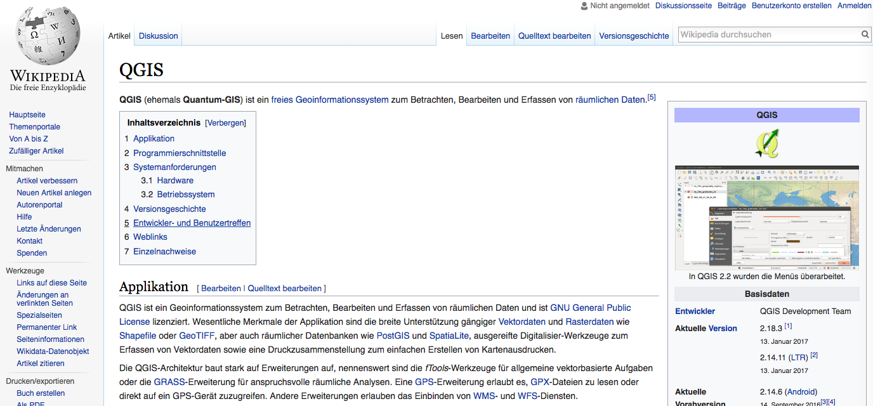
This is the time to learn 2 things :
Python (for any computing, data wrangling, graphics, analysis, documentation)
QGIS (Quantum GIS) for any spatial analysis

Slide 3
Python has become for engineers and scientists what Latin was for communication and science until the 1800s and English is today

Slide 4
No excuse:
It’s free
You carry it everywhere and alsways with you
Nobody can ever take it from you
It’s not going to go away, it’s too broadbased for that already
You only have to learn and use it (all the time, for everything)
It’s like weapons you only have to learn to shoot with them.

Slide 5
You have now the ability to analyze yourself with whatover information you can get
Databases (on the web or wherever)
Satellite information
Data from national and international sources
Your’re own data

Slide 6
You can now easily work together worldwide on any project About all scientific cooperation, worldwide, is currently done or moving to using Python

Slide 7
There are thousands of dedicated tested packages and models readily available to be used by you for any of your purposes, objections and ambitions !!

Slide 8
Millions went ahead before your. So you’re not the first, but neither the last to start. For instance: All students of the TUD / CEGS are now taught Python in year 2.

Slide 9
The rector of TUD in his new-year talk of this year:
“No student shall leave the TU without having learned to program” (in Python?)

Slide 10
Our objectives:
Get you familiar with python
Get you find your own way in python
Illustrate it’s use
Make sure that you feel sufficiently certain that you will grab it automatically and without any hesitation, whenever it’s useful.
Get familiar with what’s out there on the web

Slide 11
When is it useful
All excercises for all courses
All assignments
MsC research, PhD research
Modeling, Analysis
Data exploration and visualisation
Trying things out
Cooperate across borders and walls
Earn money, get a job … etc. etc.

Slide 12
Resources
Books
Tutorials, ebooks, pdfs
Video’s
Projects (github and others)
The I N T E R N E T for all your questions (examples etc.)
Don’t forget your colleagues, they may also help you.

Slide 13
d Books, ebooks, tutorials, videos There is a tremendous wealth of resources, tutorial, both written, in video’s and interactive online, So there is no need to by books But if you want there are about a thousand books on Amazon to teach Python

Slide 14
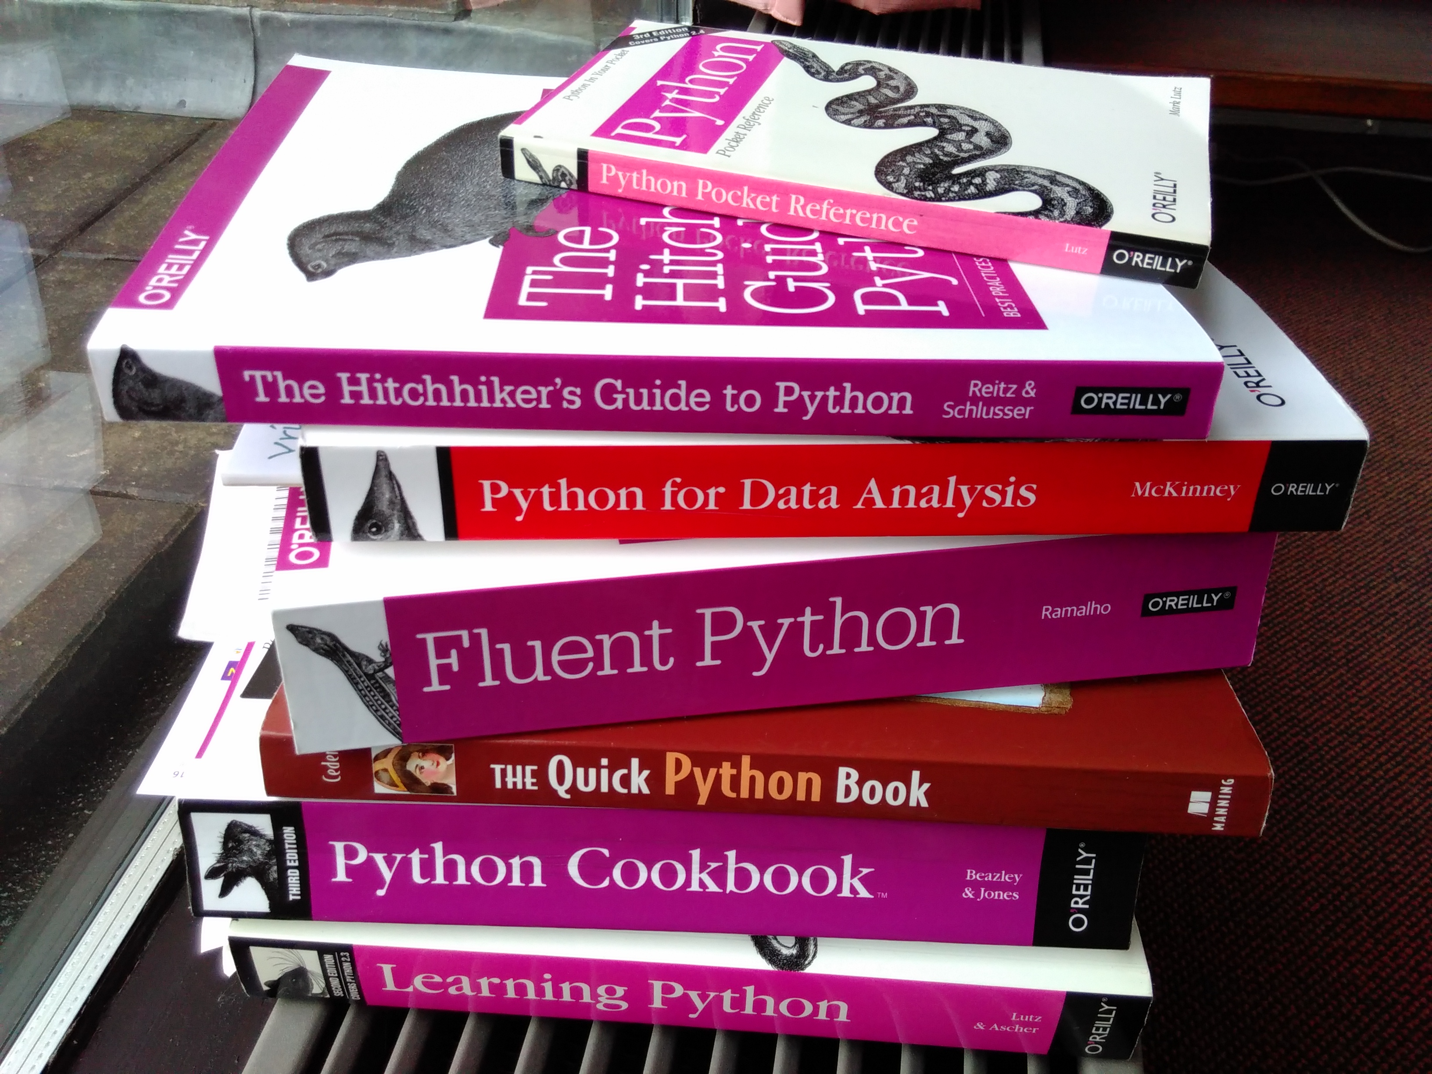
Books on Python

Slide 15
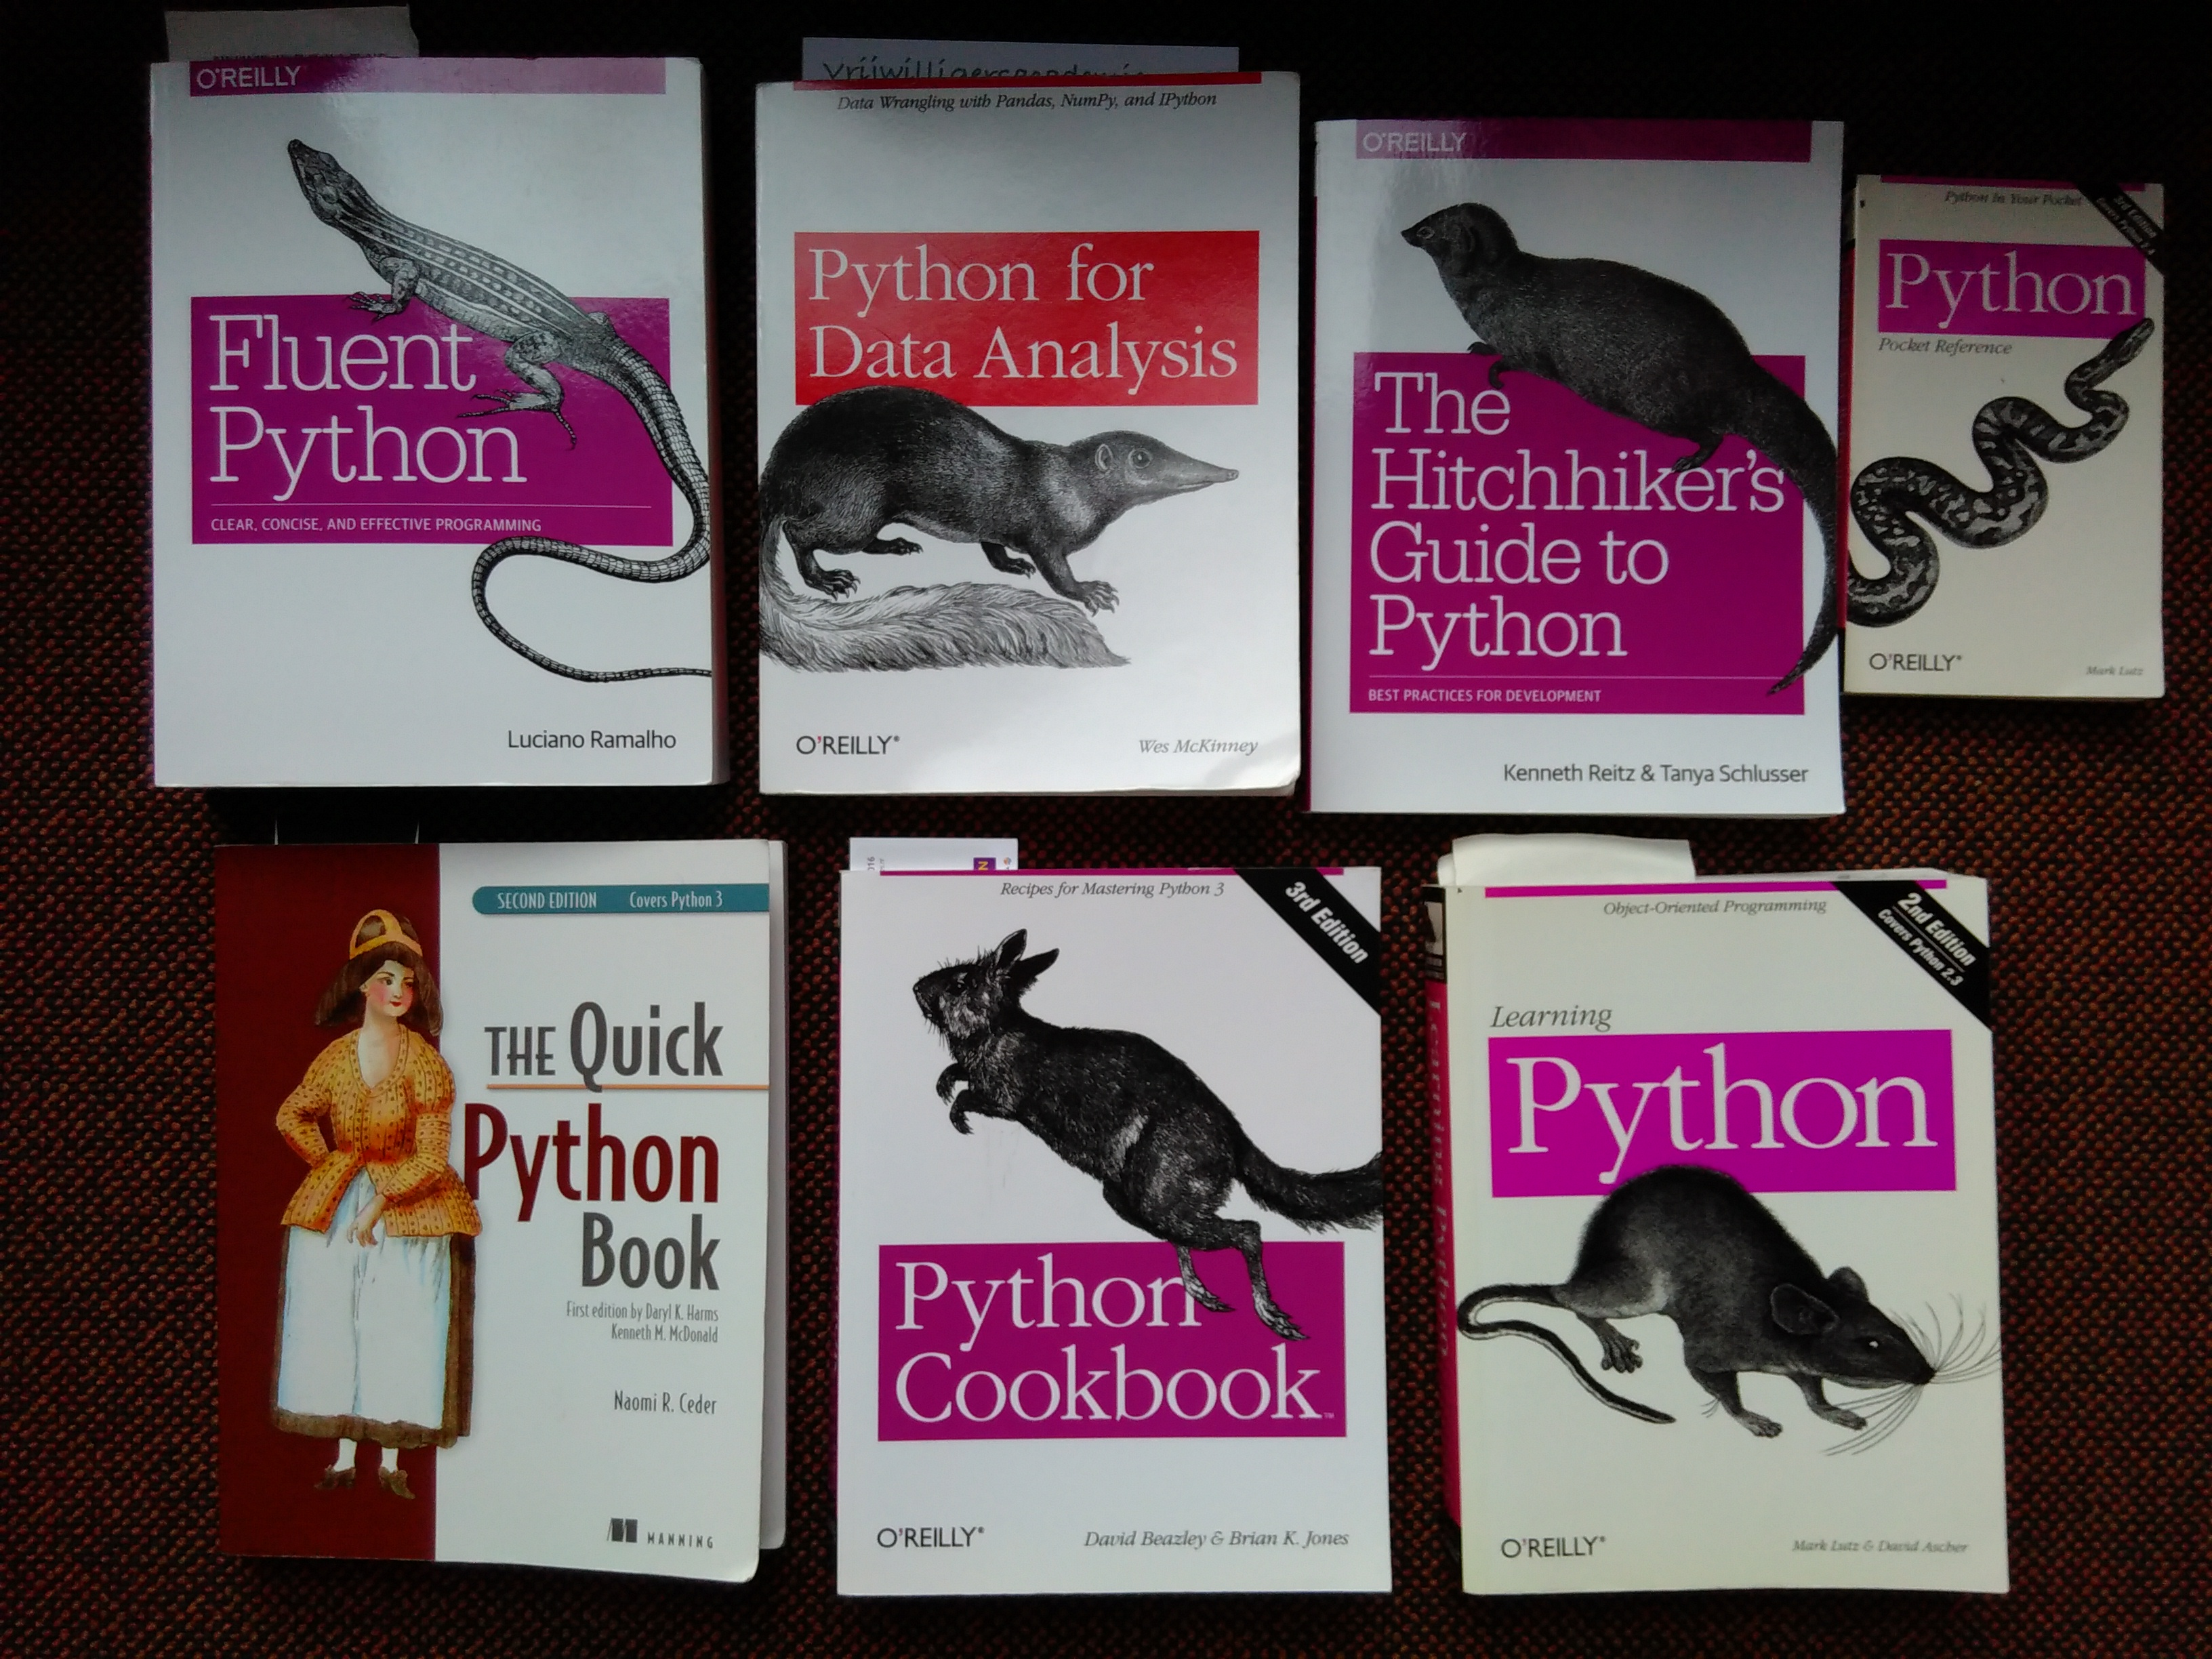
Ssame Books

Slide 16
What will we do?
Install Anaconda
Get familiar with Anaconda and Jupyter notebooks
Learn to find packages and project and install them
Tutorials (TUD, Prof. Mark Bakker) dedicated for scientists and engineers.
Examples dedicated to be useful to you of fun.

Slide 17
Where to find tutorials
Well ask Google:
Q: the best python tutorials
http://noeticforce.com/best-free-tutorials-to-learn-python-pdfs-ebooks-online-interactive
Let’s have a look

